Slide 1

Predictive model
SCOPE
Features (variables)
bacteria count/area
Predictive Model
Prediction
Data
drug/organism type
concentration

Slide 2
Machine learning classifier
70%
Train set
Train the predictive model
Data
Predictive Model
Saved Model
30%
Test set
(Unseen)
Test the model
Model: Random forest
Features
Bacteria count/area: rate of change
Bacteria count/area: growth to control ratio
Drug/organism type
Concentration
New test data
Predict growth or inhibition

Slide 3
Assumptions
List of drugs:
Ampicillin/Sulbactam, Ceftazidime, Cefepime, Ciprofloxacin, Cefotaxime, Gentamicin, Imipenem, Levofloxacin, Meropenem, Tobramycin, Piperacillin/Tazobactam
List of strains:
K.PNEUMONIAE, S.MARCESCENS, K.OXYTOCA, E.COLI, E.AEROGENES, C.FREUNDII, P.VULGARIS, P.AERUGINOSA, A.BAUMANNII, P.RETTGERI, E.CLOACAE, P.MIRABILIS
Drug ‘ST (Trimethoprim/Sulfamethoxazole)’ is excluded from all models

Slide 4
Classification methods
Model | F1 score | AUC
Random Forest | 0.86 | 0.88
XGBoost | 0.87 | 0.88
Naive Bayes | 0.62 | 0.54
AdaBoost Naive Bayes | 0.59 | 0.60

Slide 5
Separate models for different bug-drug groups
Model | # Data points | Drugs | Strains | F1 score
Random Forest - General | 63k | All | All | 0.86
Submodel 1 - Random Forest | 17k | CFPM, CAZ and CTX | All | 0.83
Submodel 2 - Random Forest | 15k | CFPM, CAZ and CTX | All except P.AERUGINOSA | 0.83
General XGBoost | 63k | All | All | 0.87
Submodel 3 - XGBoost | 17k | CFPM, CAZ and CTX | All | 0.84
Submodel 4 - XGBoost | 15k | CFPM, CAZ and CTX | All except P.AERUGINOSA | 0.84
Submodel 5 - Random Forest | 2k | CFPM, CAZ | E.COLI and K.PNEUMONIAE | 0.80

Slide 6
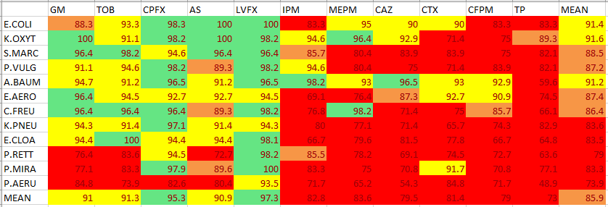
EA Accuracy Random forest- general model
EA results on test and train sets

Slide 7
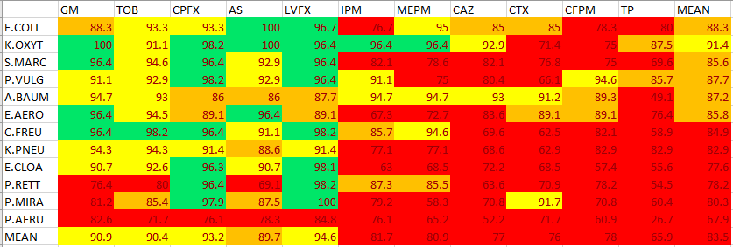
EA Accuracy XGBoost - general model
EA results on test and train sets

Slide 8
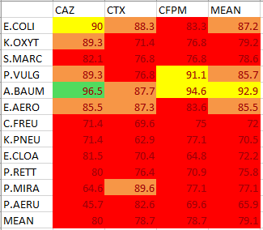
EA Accuracy Submodel 1– Random forest- CFPM, CAZ and CTX , All strains
EA results on test and train sets

Slide 9
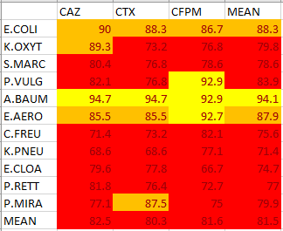
EA Accuracy Submodel 2– Random forest- CFPM, CAZ and CTX , All strains except P.AERUGINOSA
EA results on test and train sets

Slide 10
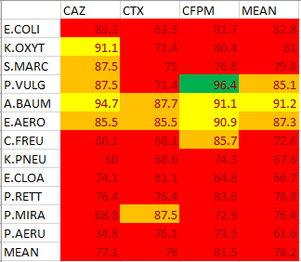
EA Accuracy Submodel 3– XGBoost - CFPM, CAZ and CTX , All strains
EA results on test and train sets

Slide 11
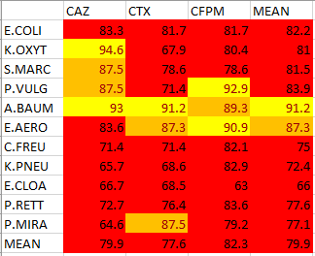
EA Accuracy Submodel 4– XGBoost - CFPM, CAZ and CTX , All strains except P.AERUGINOSA
EA results on test and train sets

Slide 12
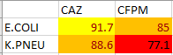
EA Accuracy Submodel 5– Random Forest – Drugs: CFPM, CAZ Strains: 'E.COLI', 'K.PNEUMONIAE'
EA results on test and train sets

Slide 13
Organism ID as feature in the model
Model | F1 score | AUC
Random Forest without organism ID | 0.865 | 0.88
Random Forest with organism ID | 0.868 | 0.88
Organism ID is not an important input

Slide 14
ML prototype model
Random Forest – General model All drugs except ST All strains
Independent from organism ID
# save the model
import pickle
filename = ‘ML-prototype-RF_V1.sav'
pickle.dump (clf, open(filename, 'wb'))
# load the model
loaded_model = pickle.load(open(filename, 'rb'))
result = loaded_model.score(X_test, Y_test)

Slide 15
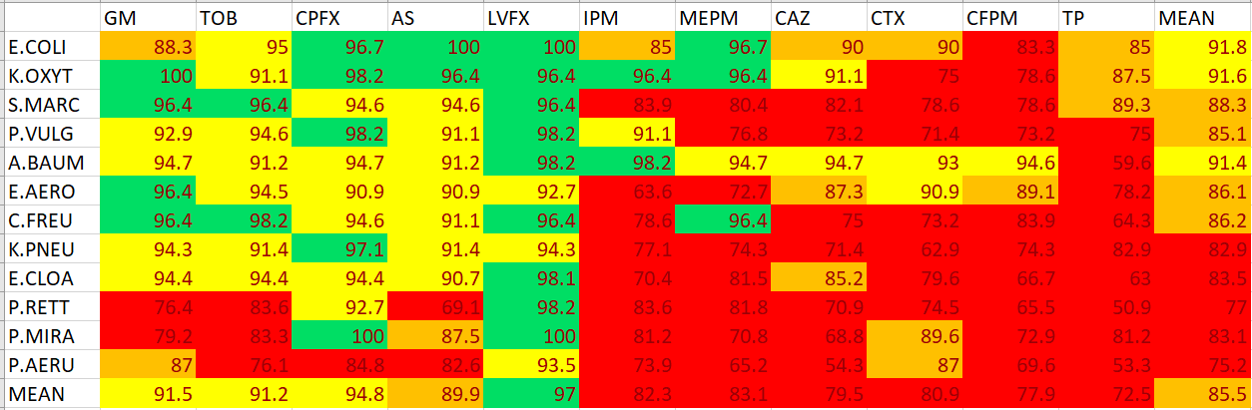
EA Accuracy Random forest- general model
EA results on test and train sets

Slide 16
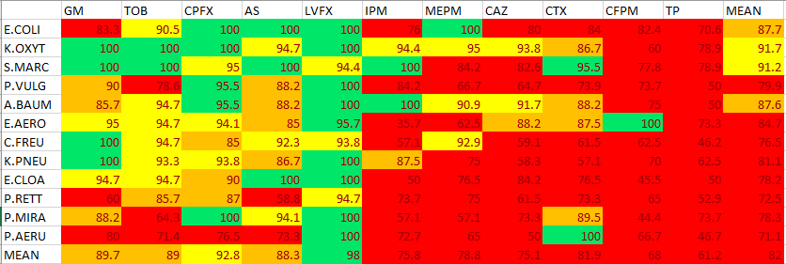
EA Accuracy Random forest- general model
EA results on test set

Slide 17
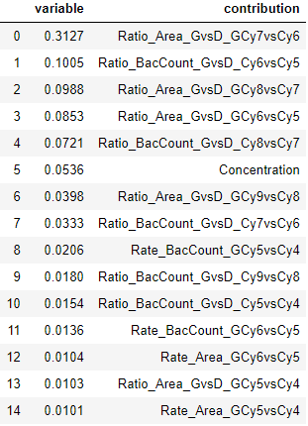
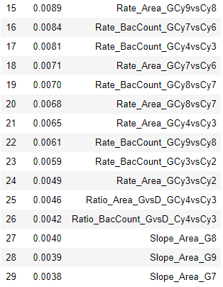
Important features
Highest contribution

Slide 18
Description of some features
Feature | Description
Rate_Area_GCy3vsCy2 | Rate of area growth
Rate_BacCount_GCy3vsCy2 | Rate of bacteria count growth
Ratio_Area_GvsD_GCy3vsCy2 | Ratio of area growth rate in growth group to control group
Ratio_BacCount_GvsD_Cy3vsCy2 | Ratio of bacteria count growth rate in growth group to control group
concentration | Concentration

Slide 19
Next steps
Build separate models for each drug
Add new data into the model
Add data from cycles 10 and 11

